Slide 1
The Path to Deep Learning with Tensorflow + Keras

Slide 2
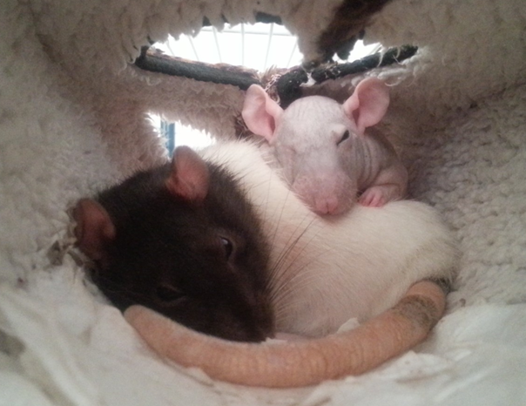
Pablo Doval
DATA PONTIFEX
I work with code and data, but don't tell my mom; she thinks I'm a piano player in a whorehouse.
@PabloDoval
palvarez@plainconcepts.com

Slide 3
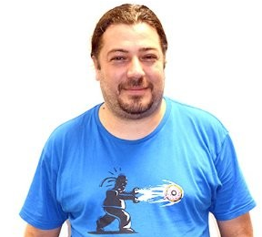
José Fernández
DATA INQUISITOR
In God we trust, others must provide data.
@jfvizoso
jfernandez@plainconcepts.com

Slide 4
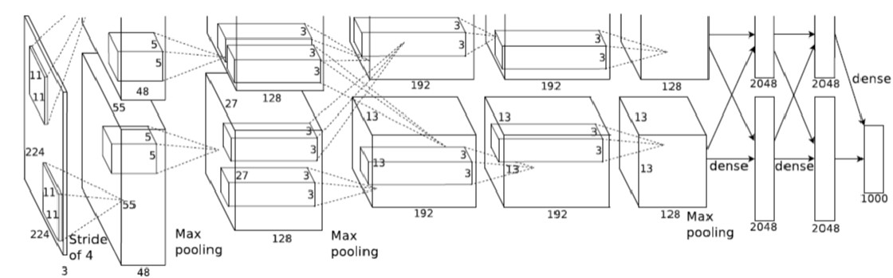
WHAT IS THIS THING?

Slide 5
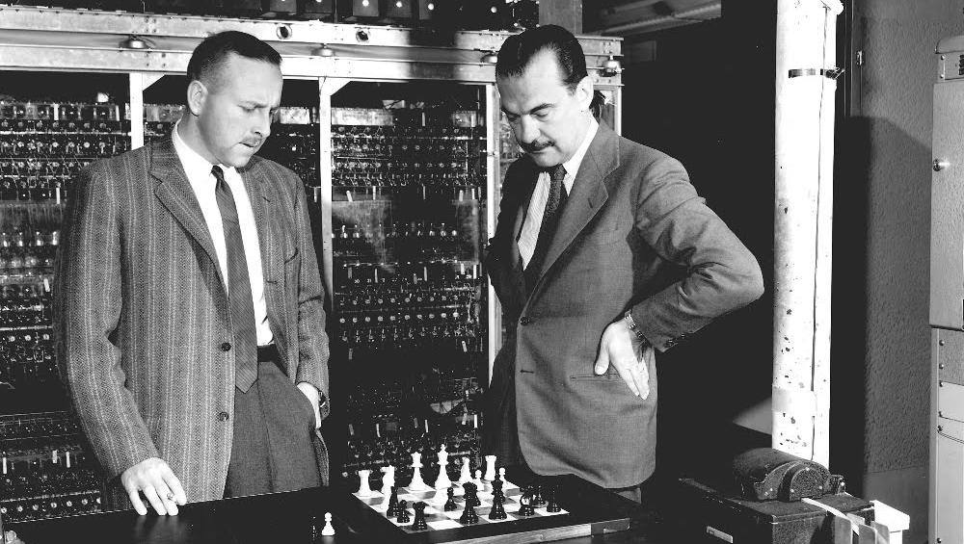
Paul Stern (left) and Nick Metropolis play chess with the MANIAC computer
Notes:
Paul Stein and Nick Metropolis, playing chess in the MANIAC 1, in Los Alamos.
First time a human was defeated in an “intellect game”. Rule based.
They dressed way better than computer scientists today :)

Slide 6
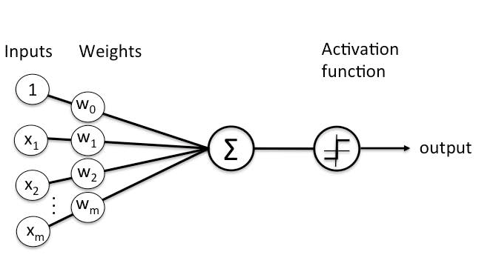
PERCEPTRON
Notes:
Frank Rossemblatt, 1956
400 photovoltaic cells as input
Weights and bias as potentiometers, electrically rotated.

Slide 7
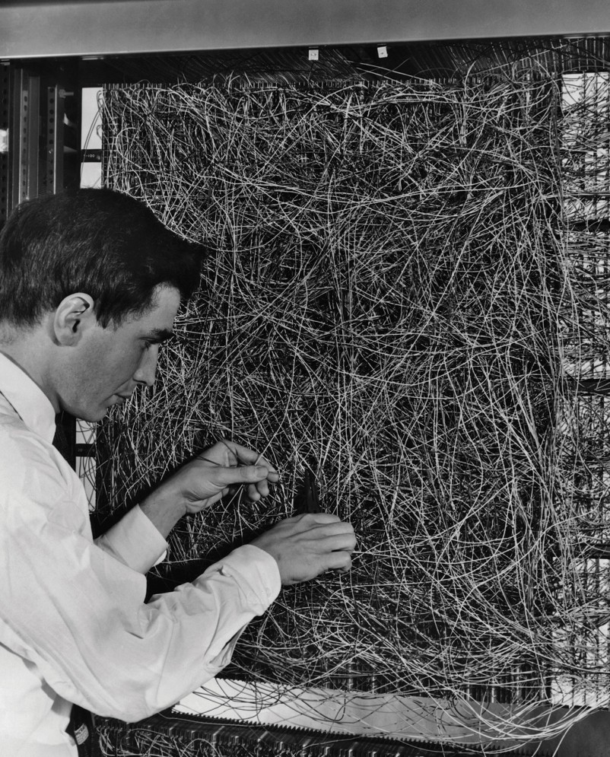
PERCEPTRON
Notes:
Frank Rossemblatt, 1956
400 photovoltaic cells as input
Wights and bias as potentiometers, electrically rotated.

Slide 8
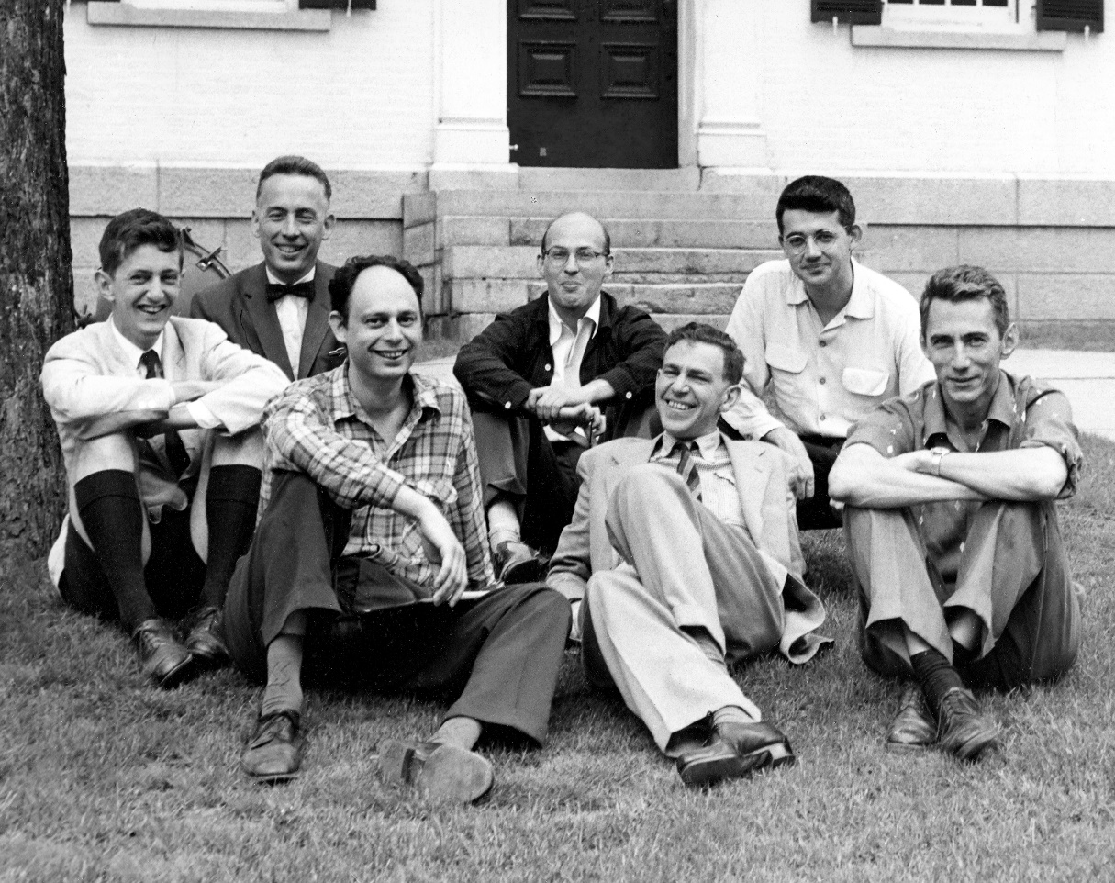
ARTIFICIAL INTELLIGENCE
Dartmouth College summer AI conference
Notes:
Marvin Minsky, Claude Shannon, Ray Solomonoff and other scientists
1956, Dartmouth Summer Research Project on Artificial Intelligence.
Still dressing better than today :)
Those were happy days…

Slide 9
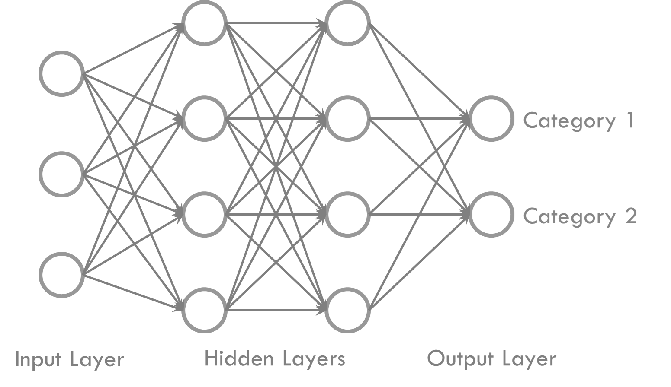
MULTILAYER PERCEPTRON
Notes:
Ivaknenko developed MLP in 1965, but…

Slide 10


Slide 11
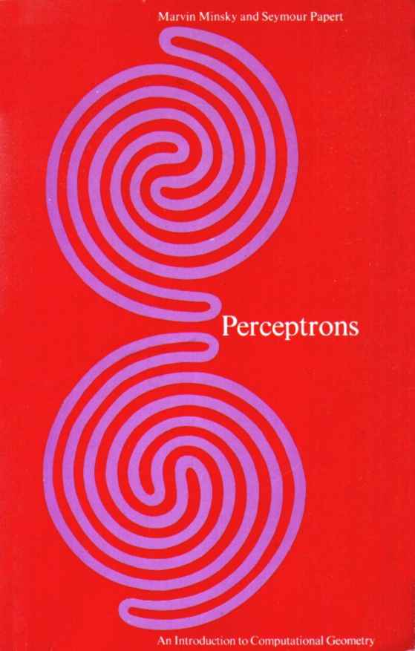
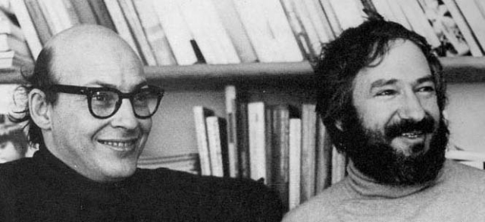
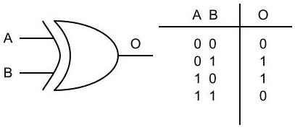
Notes:
Marvin Minksy and Seymour Papert.

Slide 12
EXPERT SYSTEMS?

Slide 13
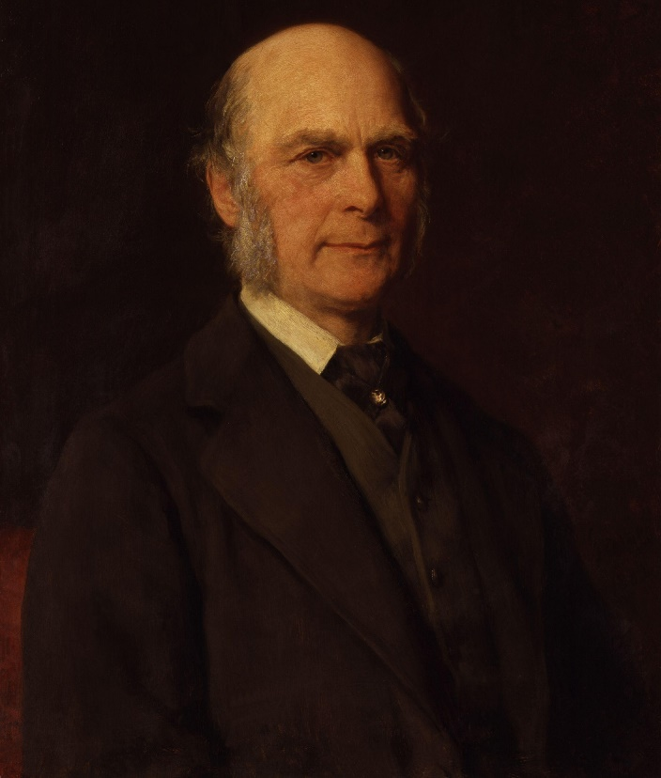
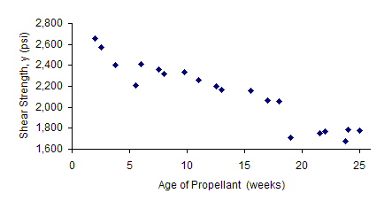
MACHINE LEARNING
Notes:
Sir Francis Galton and the linear regression.

Slide 14
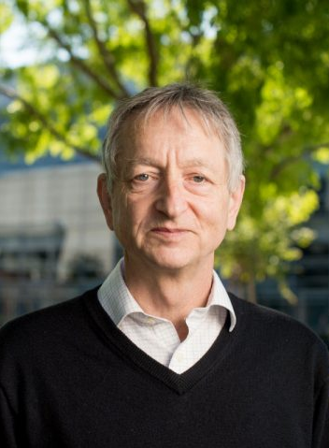
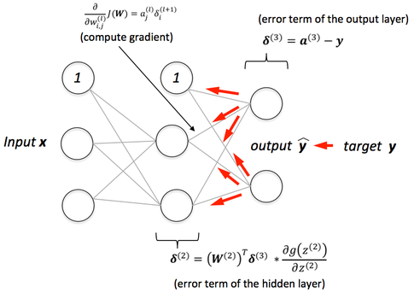
BACKPROPAGATION
Notes:
Geoff Hinton.

Slide 15
DEEP LEARNING
A Machine Learning technique

Slide 16
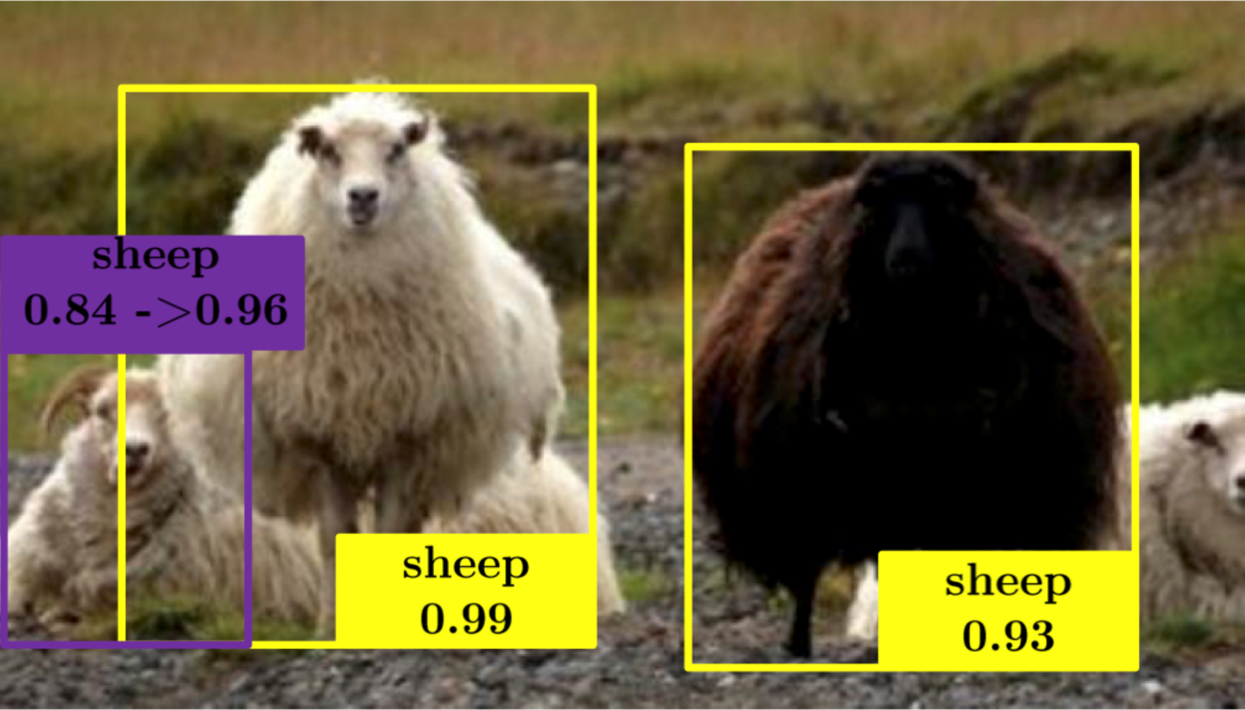

Slide 17
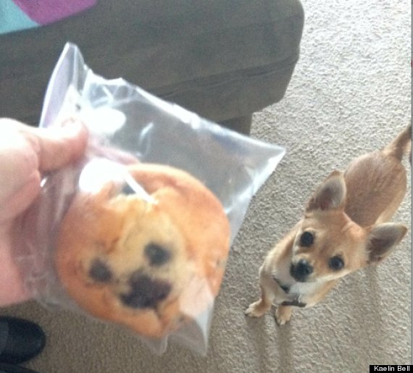

Slide 18
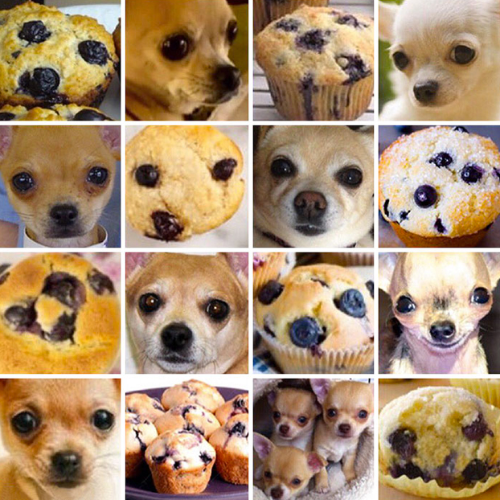

Slide 19
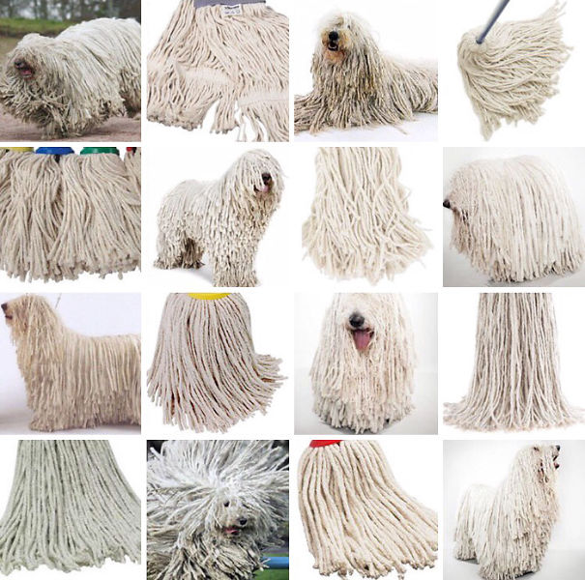

Slide 20
LAB 0: Setup

Slide 21
CHECKLIST
Anaconda
IDE
Repository
>= 5.2
Python 3.6
VS Code (or Atom, …)
Jupyter
https://github.com/jfvizoso/uclworkshop
CUDA
CUDA 9

Slide 22
AI Tech 2018 Workshop – Deep Learning
Initial Setup
First of all, please do install Anaconda 5.2 in your machine
Windows version here.
Linux versión here.
MacOS X version here.
Go to the .\scripts folder and run the script that will perform the environment setup:
environment.bat (if you are running Windows)
./environment.sh (for you, Linux folks)
Once the script finishes running, that environment will be active. The name of the environment is aitech18-deeplearningworkshop, in case you want to actívate it manually.
If you plan on using GPU – and you should! – install the CUDA toolkit from this link to the NVIDIA web page.
Run the “00 - SmokeTest.py” to check that the environment and the dependencias have been properly setup. The output will show the version of the Tensorflow and Keras distribution, as well as the number of CPUs and GPUs available in your machine

Slide 23

Azure Datascience Virtual Machines
Pre-installed installed images, configured and tested with popular tools that are commonly used for data analytics, machine learning and AI.
https://azure.microsoft.com/en-gb/services/virtual-machines/data-science-virtual-machines

Slide 24
Deep Learning with Tensorflow

Slide 25
DEEP LEARNING
Machine Learning
Based on Neural Networks
More than one hidden layer (Deep Models)

Slide 26
TensorFlow
Interface for expressing machine learning models
Why?
Multi-platform
Implementation for executing such models
Handles multiple CPUs and GPUs

Slide 27
TensorFlow
Express a numeric computation as a graph
Graph nodes are operations which have any number of inputs and outputs
Graph edges are tensors which flow between nodes
Development in Python

Slide 28
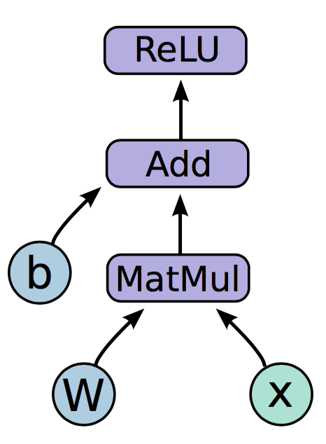
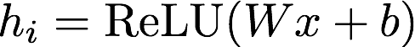
TensorFlow

Slide 29
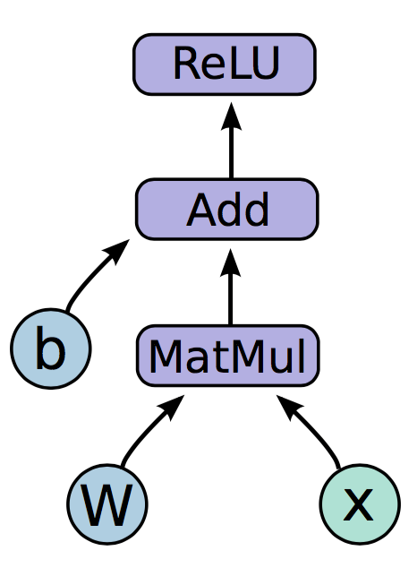
TensorFlow
Variables:
Nodes which emit their value as output
State is persisted, and retained across multiple executions of the graph
Examples: parameters

Slide 30
TensorFlow
Placeholders:
Values are fed at execution time
Examples: inputs, hyper-parameters

Slide 31
TensorFlow
Operations:
Perform the specific operation with the tensor input stream
Examples: MatMul, Add, ReLU

Slide 32
TensorFlow – Graph Code
import tensorflow as tf b = tf.Variable(tf.zeros((100,))) W = tf.Variable(tf.random_uniform((784, 100), -1, 1)) x = tf.placeholder(tf.float32, (None, 784)) h_i = tf.nn.relu(tf.matmul(x, W) + b)

Slide 33
TensorFlow – Graph Execution
Session:
Once we have defined our graph, we need to execute it
We can deploy the graph to a session
These sessions can be binded to an execution context (GPU, CPU, …)

Slide 34
TensorFlow – Execution Code
import tensorflow as tf b = tf.Variable(tf.zeros((100,))) W = tf.Variable(tf.random_uniform((784, 100), -1, 1)) x = tf.placeholder(tf.float32, (None, 784)) h_i = tf.nn.relu(tf.matmul(x, W) + b)
sess = tf.Session() sess.run(tf.initialize_all_variables()) sess.run(h_i, {x: np.random.random(64, 784)})

Slide 35
LAB 1: TensorFlow Operations

Slide 36
TensorFlow 2.0
Eager Execution as default
No need to add tf.enable_eager_execution()
Blocks or Functions can be defined to be executed in graph mode
Less conventions, more object-oriented and pythonic design
Variable_scope removed
Clean up in libraries and contrib

Slide 37
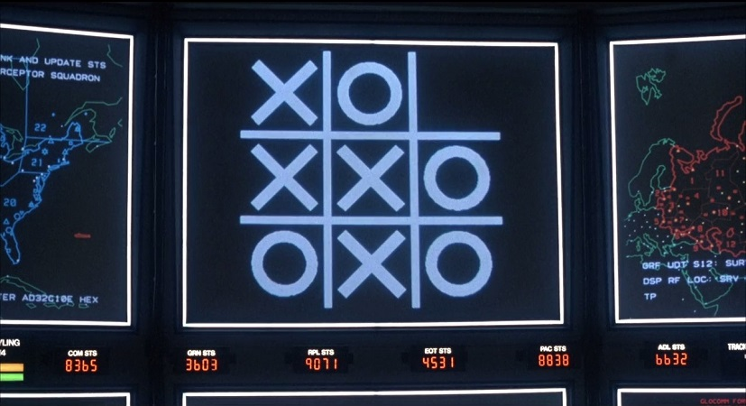
SHALL WE PLAY A LITTLE GAME?

Slide 38
A SIMPLE EXAMPLE
0 | 0 | 0 | 0 | 0 | 0 | 0 | 0 | 0
0 | 1 | 0 | 0 | 0 | 0 | 0 | 1 | 0
0 | 0 | 1 | 0 | 0 | 0 | 1 | 0 | 0
0 | 0 | 0 | 1 | 0 | 1 | 0 | 0 | 0
0 | 0 | 0 | 0 | 1 | 0 | 0 | 0 | 0
0 | 0 | 0 | 1 | 0 | 1 | 0 | 0 | 0
0 | 0 | 1 | 0 | 0 | 0 | 1 | 0 | 0
0 | 1 | 0 | 0 | 0 | 0 | 0 | 1 | 0
0 | 0 | 0 | 0 | 0 | 0 | 0 | 0 | 0
f(x)
“X”
0 | 0 | 0 | 0 | 0 | 0 | 0 | 0 | 0
0 | 0 | 0 | 1 | 1 | 1 | 0 | 0 | 0
0 | 0 | 1 | 0 | 0 | 0 | 1 | 0 | 0
0 | 1 | 0 | 0 | 0 | 0 | 0 | 1 | 0
0 | 1 | 0 | 0 | 0 | 0 | 0 | 1 | 0
0 | 1 | 0 | 0 | 0 | 0 | 0 | 1 | 0
0 | 0 | 1 | 0 | 0 | 0 | 1 | 0 | 0
0 | 0 | 0 | 1 | 1 | 1 | 0 | 0 | 0
0 | 0 | 0 | 0 | 0 | 0 | 0 | 0 | 0
f(x)
“O”

Slide 39

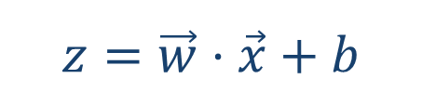
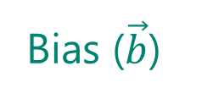
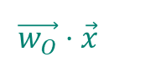
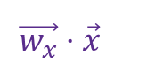
A SIMPLE EXAMPLE
81 values ($\vec{x}$)
Bias ($\vec{b}$)
…
…
1 | 0 | 0 | 0 | 0 | 0 | 0 | 0 | 0
0 | 1 | 0 | 0 | 0 | 0 | 1 | 0 | 0
0 | 0 | 1 | 0 | 0 | 1 | 0 | 0 | 0
0 | 0 | 0 | 1 | 1 | 0 | 0 | 0 | 0
0 | 0 | 0 | 1 | 1 | 0 | 0 | 0 | 0
0 | 0 | 1 | 0 | 0 | 1 | 0 | 0 | 0
0 | 1 | 0 | 0 | 0 | 0 | 1 | 0 | 0
0 | 0 | 0 | 0 | 0 | 0 | 1 | 0 | 0
0 | 0 | 0 | 0 | 0 | 0 | 0 | 0 | 0
9 pixels
Ʃ
Ʃ
9 pixels
Ʃ
Sum (weights x pixels) =
$$\vec{w_{x}}⋅\vec{x}$$
Ʃ
Sum (weights x pixels) =
$$\vec{w_{O}}⋅\vec{x}$$
$$z=\vec{w}⋅\vec{x}+b$$

Slide 40
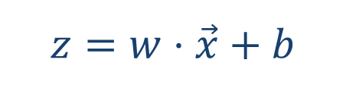
NOW THAT YOU MENTION IT…
$$z=w⋅\vec{x}+b$$

Slide 41
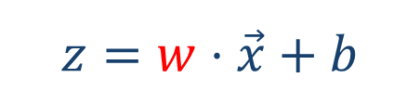
NOW THAT YOU MENTION IT…
$$z=w⋅\vec{x}+b$$

Slide 42
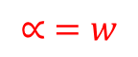
NOW THAT YOU MENTION IT…
$$z=w⋅\vec{x}+b$$
$$∝ =w$$

Slide 43
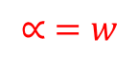
NOW THAT YOU MENTION IT…
$$z=w⋅\vec{x}+b$$
$$∝ =w$$

Slide 44
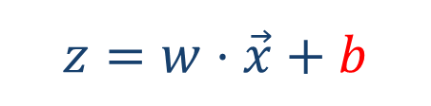
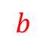
NOW THAT YOU MENTION IT…
$$z=w⋅\vec{x}+b$$
$$b$$

Slide 45
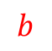
NOW THAT YOU MENTION IT…
$$z=w⋅\vec{x}+b$$
$$b$$

Slide 46
SIGMOID
81 values ($\vec{x}$)
…
…
1 | 0 | 0 | 0 | 0 | 0 | 0 | 0 | 0
0 | 1 | 0 | 0 | 0 | 0 | 1 | 0 | 0
0 | 0 | 1 | 0 | 0 | 1 | 0 | 0 | 0
0 | 0 | 0 | 1 | 1 | 0 | 0 | 0 | 0
0 | 0 | 0 | 1 | 1 | 0 | 0 | 0 | 0
0 | 0 | 1 | 0 | 0 | 1 | 0 | 0 | 0
0 | 1 | 0 | 0 | 0 | 0 | 1 | 0 | 0
0 | 0 | 0 | 0 | 0 | 0 | 1 | 0 | 0
0 | 0 | 0 | 0 | 0 | 0 | 0 | 0 | 0
9 pixels
Ʃ
Ʃ
9 pixels
823,731.01
14,78

Slide 47
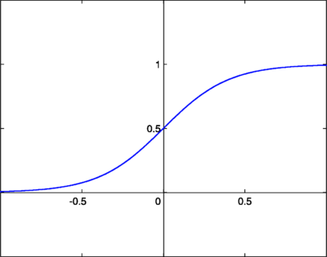
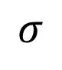
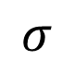
SIGMOID
81 values ($\vec{x}$)
…
…
1 | 0 | 0 | 0 | 0 | 0 | 0 | 0 | 0
0 | 1 | 0 | 0 | 0 | 0 | 1 | 0 | 0
0 | 0 | 1 | 0 | 0 | 1 | 0 | 0 | 0
0 | 0 | 0 | 1 | 1 | 0 | 0 | 0 | 0
0 | 0 | 0 | 1 | 1 | 0 | 0 | 0 | 0
0 | 0 | 1 | 0 | 0 | 1 | 0 | 0 | 0
0 | 1 | 0 | 0 | 0 | 0 | 1 | 0 | 0
0 | 0 | 0 | 0 | 0 | 0 | 1 | 0 | 0
0 | 0 | 0 | 0 | 0 | 0 | 0 | 0 | 0
9 pixels
Ʃ
Ʃ
9 pixels
$$σ$$
$$σ$$
0.78
0.32

Slide 48
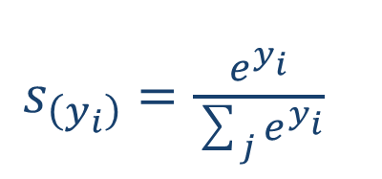
SOFTMAX
81 values ($\vec{x}$)
…
…
1 | 0 | 0 | 0 | 0 | 0 | 0 | 0 | 0
0 | 1 | 0 | 0 | 0 | 0 | 1 | 0 | 0
0 | 0 | 1 | 0 | 0 | 1 | 0 | 0 | 0
0 | 0 | 0 | 1 | 1 | 0 | 0 | 0 | 0
0 | 0 | 0 | 1 | 1 | 0 | 0 | 0 | 0
0 | 0 | 1 | 0 | 0 | 1 | 0 | 0 | 0
0 | 1 | 0 | 0 | 0 | 0 | 1 | 0 | 0
0 | 0 | 0 | 0 | 0 | 0 | 1 | 0 | 0
0 | 0 | 0 | 0 | 0 | 0 | 0 | 0 | 0
$s_{\left(y_{i}\right)}=\frac{ⅇ^{y_{i}}}{\sum_{j}{ⅇ^{y_{i}}}}$
9 pixels
Ʃ
Ʃ
9 pixels
0.75
0.25
These are actual probabilities

Slide 49
LOSS FUNCTION
One-hot encoding
1 | 0 | 0 | 0 | 0 | 0 | 0 | 0 | 0
0 | 1 | 0 | 0 | 0 | 0 | 1 | 0 | 0
0 | 0 | 1 | 0 | 0 | 1 | 0 | 0 | 0
0 | 0 | 0 | 1 | 1 | 0 | 0 | 0 | 0
0 | 0 | 0 | 1 | 1 | 0 | 0 | 0 | 0
0 | 0 | 1 | 0 | 0 | 1 | 0 | 0 | 0
0 | 1 | 0 | 0 | 0 | 0 | 1 | 0 | 0
0 | 0 | 0 | 0 | 0 | 0 | 1 | 0 | 0
0 | 0 | 0 | 0 | 0 | 0 | 0 | 0 | 0
1
0
9 pixels
9 pixels
0.75
0.25

Slide 50
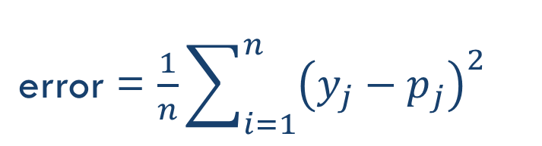
LOSS FUNCTION
1 | 0 | 0 | 0 | 0 | 0 | 0 | 0 | 0
0 | 1 | 0 | 0 | 0 | 0 | 1 | 0 | 0
0 | 0 | 1 | 0 | 0 | 1 | 0 | 0 | 0
0 | 0 | 0 | 1 | 1 | 0 | 0 | 0 | 0
0 | 0 | 0 | 1 | 1 | 0 | 0 | 0 | 0
0 | 0 | 1 | 0 | 0 | 1 | 0 | 0 | 0
0 | 1 | 0 | 0 | 0 | 0 | 1 | 0 | 0
0 | 0 | 0 | 0 | 0 | 0 | 1 | 0 | 0
0 | 0 | 0 | 0 | 0 | 0 | 0 | 0 | 0
1
0
9 pixels
error = $\frac{1}{n}\sum_{i=1}^{n}{{\left(y_{j}−p_{j}\right)}^{2}}$
9 pixels
0.75
0.25

Slide 51
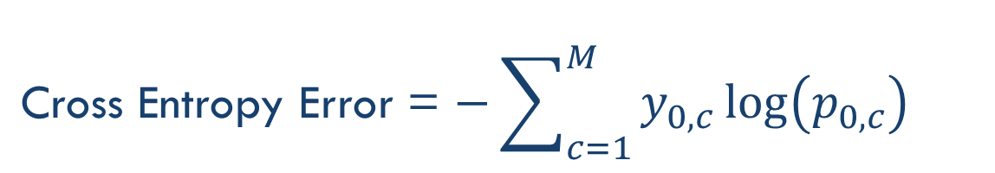
LOSS FUNCTION
1 | 0 | 0 | 0 | 0 | 0 | 0 | 0 | 0
0 | 1 | 0 | 0 | 0 | 0 | 1 | 0 | 0
0 | 0 | 1 | 0 | 0 | 1 | 0 | 0 | 0
0 | 0 | 0 | 1 | 1 | 0 | 0 | 0 | 0
0 | 0 | 0 | 1 | 1 | 0 | 0 | 0 | 0
0 | 0 | 1 | 0 | 0 | 1 | 0 | 0 | 0
0 | 1 | 0 | 0 | 0 | 0 | 1 | 0 | 0
0 | 0 | 0 | 0 | 0 | 0 | 1 | 0 | 0
0 | 0 | 0 | 0 | 0 | 0 | 0 | 0 | 0
1
0
9 pixels
Cross Entropy Error = $−\sum_{c=1}^{M}{{y_{0,c}\log\left(p_{0,c}\right)}^{}}$
9 pixels
Binary: −(y*log(p) + (1−y)*log(1−p))
0.75
0.25

Slide 52
TRAINING
x = vector of pixels (input)
x = vector of pixels (input)
…
…
…
…
…
…
…
…
…
…
…
…
…
…
…
…
…
…
…
…
…
…
…
…
.
.
.
.
.
.
.
.
z = times(x, W) + b
cross_entropy_with_softmax(z, y)
classification_error(z, y)
…
…
…
…
…
…
…
…
(1, 0)
(0, 1)
(1, 0)
y = label vector (one-hot)
Training Data

Slide 53
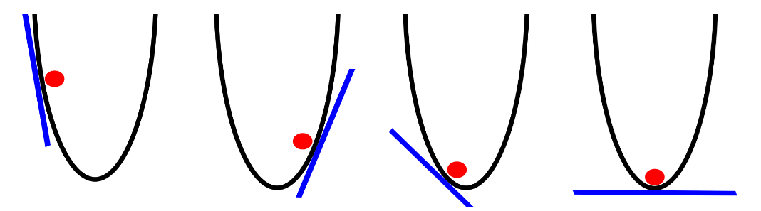
GRADIENT DESCENT

Slide 54
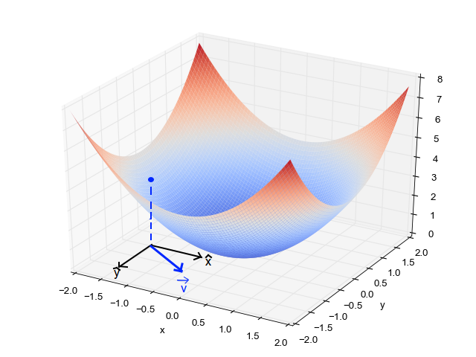
GRADIENT DESCENT

Slide 55
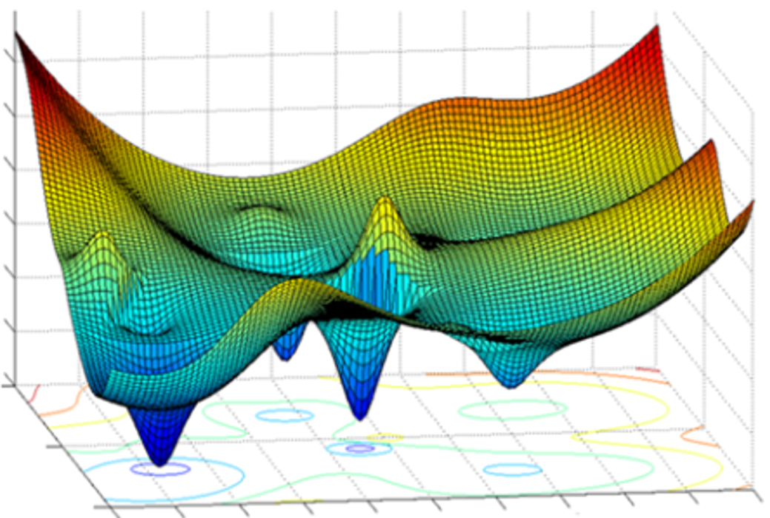
GRADIENT DESCENT

Slide 56
LAB 2: Logistic Regression

Slide 57



Keras
Mission: to make building Deep architectures easier
Works on top of TensorFlow or Theano
Built by François Chollet at Google

Slide 58
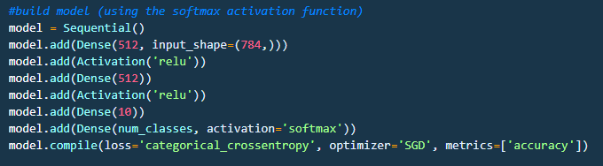
Keras
Based on layers and their input/output tensors

Slide 59
LAB 3: Logistic Regression (Keras)

Slide 60
Neural Networks

Slide 61
NEURAL NETWORK (CLASSIFIER)
Category 1
Category 2
Input Layer
Hidden Layers
Output Layer

Slide 62
NEURAL NETWORK (CLASSIFIER)
Category 1
Category 2
Input Layer
Hidden Layers
Output Layer

Slide 63
FORWARD PROPAGATION
Category 1
Category 2
Input Layer
Hidden Layers
Output Layer

Slide 64
FORWARD PROPAGATION
Category 1
Category 2
Input Layer
Hidden Layers
Output Layer

Slide 65
FORWARD PROPAGATION
Category 1
Category 2
Input Layer
Hidden Layers
Output Layer

Slide 66
FORWARD PROPAGATION
Category 1
Category 2
Input Layer
Hidden Layers
Output Layer

Slide 67
TRAINING
Cost = Generated Value – Ground Truth
Category 1
Category 2
Input Layer
Hidden Layers
Output Layer

Slide 68
BACKPROPAGATION
Cost = Generated Value – Ground Truth
Category 1
Error = X
Category 2
Input Layer
Hidden Layers
Output Layer

Slide 69
LAB 4: Multi-Layer Perceptron

Slide 70
Convolutional Networks

Slide 71
REMEMBER THIS THING?

Slide 72
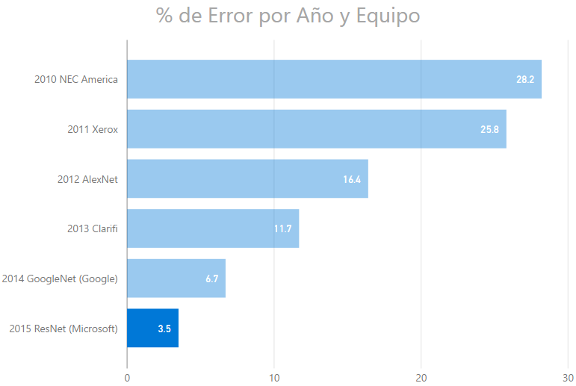
IMAGENET CHALLENGE

Slide 73
FILTERING
0 | 0 | 0 | 0 | 0 | 0 | 0 | 0 | 0
0 | 1 | 0 | 0 | 0 | 0 | 0 | 1 | 0
0 | 0 | 1 | 0 | 0 | 0 | 1 | 0 | 0
0 | 0 | 0 | 1 | 0 | 1 | 0 | 0 | 0
0 | 0 | 0 | 0 | 1 | 0 | 0 | 0 | 0
0 | 0 | 0 | 1 | 0 | 1 | 0 | 0 | 0
0 | 0 | 1 | 0 | 0 | 0 | 1 | 0 | 0
0 | 1 | 0 | 0 | 0 | 0 | 0 | 1 | 0
0 | 0 | 0 | 0 | 0 | 0 | 0 | 0 | 0
0 | 0 | 0 | 0 | 0 | 0 | 0 | 0 | 0
0 | 0 | 0 | 0 | 0 | 0 | 1 | 0 | 0
0 | 1 | 0 | 0 | 0 | 1 | 0 | 0 | 0
0 | 0 | 1 | 1 | 0 | 1 | 0 | 0 | 0
0 | 0 | 0 | 0 | 1 | 0 | 0 | 0 | 0
0 | 0 | 0 | 1 | 0 | 1 | 1 | 0 | 0
0 | 0 | 0 | 1 | 0 | 0 | 0 | 1 | 0
0 | 0 | 1 | 0 | 0 | 0 | 0 | 0 | 0
0 | 0 | 0 | 0 | 0 | 0 | 0 | 0 | 0
0 | 0 | 0 | 0 | 0 | 0 | 0 | 0 | 0
0 | 0 | 0 | 0 | 0 | 0 | 1 | 0 | 0
0 | 1 | 0 | 0 | 0 | 1 | 0 | 0 | 0
0 | 0 | 1 | 1 | 0 | 1 | 0 | 0 | 0
0 | 0 | 0 | 0 | 1 | 0 | 0 | 0 | 0
0 | 0 | 0 | 1 | 0 | 1 | 1 | 0 | 0
0 | 0 | 0 | 1 | 0 | 0 | 0 | 1 | 0
0 | 0 | 1 | 0 | 0 | 0 | 0 | 0 | 0
0 | 0 | 0 | 0 | 0 | 0 | 0 | 0 | 0

Slide 74
FILTERING
…looking for common characteristics
Filter 1
Filter 2
Filter 3
1 | -1 | -1
-1 | 1 | -1
-1 | -1 | 1
-1 | -1 | 1
-1 | 1 | -1
1 | -1 | -1
1 | -1 | 1
-1 | 1 | -1
1 | -1 | 1
-1 | -1 | -1 | -1 | -1 | -1 | -1 | -1 | -1
-1 | 1 | -1 | -1 | -1 | -1 | -1 | 1 | -1
-1 | -1 | 1 | -1 | -1 | -1 | 1 | -1 | -1
-1 | -1 | -1 | 1 | -1 | 1 | -1 | -1 | -1
-1 | -1 | -1 | -1 | 1 | -1 | -1 | -1 | -1
-1 | -1 | -1 | 1 | -1 | 1 | -1 | -1 | -1
-1 | -1 | 1 | -1 | -1 | -1 | 1 | -1 | -1
-1 | 1 | -1 | -1 | -1 | -1 | -1 | 1 | -1
-1 | -1 | -1 | -1 | -1 | -1 | -1 | -1 | -1
1 | 1 | 1
1 | 1 | 1
1 | 1 | 1
-1 | 1 | -1
1 | 1 | 1
-1 | 1 | -1
1 | 1 | -1
1 | 1 | 1
-1 | 1 | 1
1.0
0.11
0.55

Slide 75
CONVOLUTION
Filter
-1 | -1 | -1 | -1 | -1 | -1 | -1 | -1 | -1
-1 | 1 | -1 | -1 | -1 | -1 | -1 | 1 | -1
-1 | -1 | 1 | -1 | -1 | -1 | 1 | -1 | -1
-1 | -1 | -1 | 1 | -1 | 1 | -1 | -1 | -1
-1 | -1 | -1 | -1 | 1 | -1 | -1 | -1 | -1
-1 | -1 | -1 | 1 | -1 | 1 | -1 | -1 | -1
-1 | -1 | 1 | -1 | -1 | -1 | 1 | -1 | -1
-1 | 1 | -1 | -1 | -1 | -1 | -1 | 1 | -1
-1 | -1 | -1 | -1 | -1 | -1 | -1 | -1 | -1
0.77 | -0.11 | 0.11 | 0.33 | 0.55 | -0.11 | 0.33
-0.11 | 1.00 | -0.11 | 0.33 | -0.11 | 0.11 | -0.11
0.11 | -0.11 | 1.00 | -0.33 | 0.11 | -0.11 | 0.55
0.33 | 0.33 | -0.33 | 0.55 | -0.33 | 0.33 | 0.33
0.55 | -0.11 | 0.11 | -0.33 | 1.00 | -0.11 | 0.11
-0.11 | 0.11 | -0.11 | 0.33 | -0.11 | 1.00 | -0.11
0.33 | -0.11 | 0.55 | 0.33 | 0.11 | -0.11 | 0.77
1 | -1 | -1
-1 | 1 | -1
-1 | -1 | 1

Slide 76

CONVOLUTION
-1 | -1 | -1 | -1 | -1 | -1 | -1 | -1 | -1
-1 | 1 | -1 | -1 | -1 | -1 | -1 | 1 | -1
-1 | -1 | 1 | -1 | -1 | -1 | 1 | -1 | -1
-1 | -1 | -1 | 1 | -1 | 1 | -1 | -1 | -1
-1 | -1 | -1 | -1 | 1 | -1 | -1 | -1 | -1
-1 | -1 | -1 | 1 | -1 | 1 | -1 | -1 | -1
-1 | -1 | 1 | -1 | -1 | -1 | 1 | -1 | -1
-1 | 1 | -1 | -1 | -1 | -1 | -1 | 1 | -1
-1 | -1 | -1 | -1 | -1 | -1 | -1 | -1 | -1
0.77 | -0.11 | 0.11 | 0.33 | 0.55 | -0.11 | 0.33
-0.11 | 1.00 | -0.11 | 0.33 | -0.11 | 0.11 | -0.11
0.11 | -0.11 | 1.00 | -0.33 | 0.11 | -0.11 | 0.55
0.33 | 0.33 | -0.33 | 0.55 | -0.33 | 0.33 | 0.33
0.55 | -0.11 | 0.11 | -0.33 | 1.00 | -0.11 | 0.11
-0.11 | 0.11 | -0.11 | 0.33 | -0.11 | 1.00 | -0.11
0.33 | -0.11 | 0.55 | 0.33 | 0.11 | -0.11 | 0.77
$$⊗$$
=
1 | -1 | -1
-1 | 1 | -1
-1 | -1 | 1

Slide 77


CONVOLUTION
-1 | -1 | -1 | -1 | -1 | -1 | -1 | -1 | -1
-1 | 1 | -1 | -1 | -1 | -1 | -1 | 1 | -1
-1 | -1 | 1 | -1 | -1 | -1 | 1 | -1 | -1
-1 | -1 | -1 | 1 | -1 | 1 | -1 | -1 | -1
-1 | -1 | -1 | -1 | 1 | -1 | -1 | -1 | -1
-1 | -1 | -1 | 1 | -1 | 1 | -1 | -1 | -1
-1 | -1 | 1 | -1 | -1 | -1 | 1 | -1 | -1
-1 | 1 | -1 | -1 | -1 | -1 | -1 | 1 | -1
-1 | -1 | -1 | -1 | -1 | -1 | -1 | -1 | -1
0.77 | -0.11 | 0.11 | 0.33 | 0.55 | -0.11 | 0.33
-0.11 | 1.00 | -0.11 | 0.33 | -0.11 | 0.11 | -0.11
0.11 | -0.11 | 1.00 | -0.33 | 0.11 | -0.11 | 0.55
0.33 | 0.33 | -0.33 | 0.55 | -0.33 | 0.33 | 0.33
0.55 | -0.11 | 0.11 | -0.33 | 1.00 | -0.11 | 0.11
-0.11 | 0.11 | -0.11 | 0.33 | -0.11 | 1.00 | -0.11
0.33 | -0.11 | 0.55 | 0.33 | 0.11 | -0.11 | 0.77
$$⊗$$
=
1 | -1 | -1
-1 | 1 | -1
-1 | -1 | 1
-1 | -1 | -1 | -1 | -1 | -1 | -1 | -1 | -1
-1 | 1 | -1 | -1 | -1 | -1 | -1 | 1 | -1
-1 | -1 | 1 | -1 | -1 | -1 | 1 | -1 | -1
-1 | -1 | -1 | 1 | -1 | 1 | -1 | -1 | -1
-1 | -1 | -1 | -1 | 1 | -1 | -1 | -1 | -1
-1 | -1 | -1 | 1 | -1 | 1 | -1 | -1 | -1
-1 | -1 | 1 | -1 | -1 | -1 | 1 | -1 | -1
-1 | 1 | -1 | -1 | -1 | -1 | -1 | 1 | -1
-1 | -1 | -1 | -1 | -1 | -1 | -1 | -1 | -1
$$⊗$$
0.33 | -0.11 | 0.55 | 0.33 | 0.11 | -0.11 | 0.77
-0.11 | 0.11 | -0.11 | 0.33 | -0.11 | 1.00 | -0.11
0.55 | -0.11 | 0.11 | -0.33 | 1.00 | -0.11 | 0.11
0.33 | 0.33 | -0.33 | 0.55 | -0.33 | 0.33 | 0.33
0.11 | -0.11 | 1.00 | -0.33 | 0.11 | -0.11 | 0.55
-0.11 | 1.00 | -0.11 | 0.33 | -0.11 | 0.11 | -0.11
0.77 | -0.11 | 0.11 | 0.33 | 0.55 | -0.11 | 0.33
=
-1 | -1 | 1
-1 | 1 | -1
1 | -1 | -1

Slide 78

0.77 | -0.11 | 0.11 | 0.33 | 0.55 | -0.11 | 0.33
-0.11 | 1.00 | -0.11 | 0.33 | -0.11 | 0.11 | -0.11
0.11 | -0.11 | 1.00 | -0.33 | 0.11 | -0.11 | 0.55
0.33 | 0.33 | -0.33 | 0.55 | -0.33 | 0.33 | 0.33
0.55 | -0.11 | 0.11 | -0.33 | 1.00 | -0.11 | 0.11
-0.11 | 0.11 | -0.11 | 0.33 | -0.11 | 1.00 | -0.11
0.33 | -0.11 | 0.55 | 0.33 | 0.11 | -0.11 | 0.77
1 | -1 | -1
-1 | 1 | -1
-1 | -1 | 1
-1 | -1 | -1 | -1 | -1 | -1 | -1 | -1 | -1
-1 | 1 | -1 | -1 | -1 | -1 | -1 | 1 | -1
-1 | -1 | 1 | -1 | -1 | -1 | 1 | -1 | -1
-1 | -1 | -1 | 1 | -1 | 1 | -1 | -1 | -1
-1 | -1 | -1 | -1 | 1 | -1 | -1 | -1 | -1
-1 | -1 | -1 | 1 | -1 | 1 | -1 | -1 | -1
-1 | -1 | 1 | -1 | -1 | -1 | 1 | -1 | -1
-1 | 1 | -1 | -1 | -1 | -1 | -1 | 1 | -1
-1 | -1 | -1 | -1 | -1 | -1 | -1 | -1 | -1
$$⊗$$
=
0.33 | -0.55 | -0.11 | -0.11 | 0.11 | -0.55 | 0.33
-0.55 | 0.55 | -0.55 | 0.33 | -0.55 | 0.55 | -0.55
0.11 | -0.55 | 0.55 | -0.77 | 0.55 | -0.55 | 0.11
-0.11 | 0.33 | -0.77 | 1.00 | -0.77 | 0.33 | -0.11
0.11 | -0.55 | 0.55 | -0.77 | 0.55 | -0.55 | 0.11
-0.55 | 0.55 | -0.55 | 0.33 | -0.55 | 0.55 | -0.55
0.33 | -0.55 | 0.11 | -0.11 | 0.11 | -0.55 | 0.33
1 | -1 | 1
-1 | 1 | -1
1 | -1 | 1
0.33 | -0.11 | 0.55 | 0.33 | 0.11 | -0.11 | 0.77
-0.11 | 0.11 | -0.11 | 0.33 | -0.11 | 1.00 | -0.11
0.55 | -0.11 | 0.11 | -0.33 | 1.00 | -0.11 | 0.11
0.33 | 0.33 | -0.33 | 0.55 | -0.33 | 0.33 | 0.33
0.11 | -0.11 | 1.00 | -0.33 | 0.11 | -0.11 | 0.55
-0.11 | 1.00 | -0.11 | 0.33 | -0.11 | 0.11 | -0.11
0.77 | -0.11 | 0.11 | 0.33 | 0.55 | -0.11 | 0.33
-1 | -1 | 1
-1 | 1 | -1
1 | -1 | -1

Slide 79



STRIDES AND PADDING
source: https://github.com/vdumoulin/conv_arithmetic

Slide 80
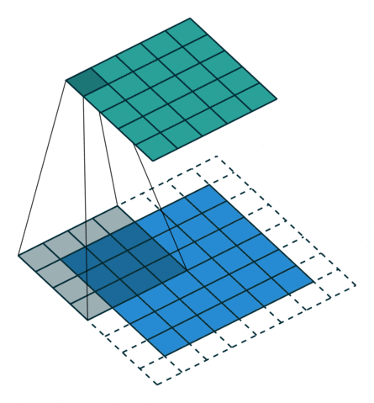

DECONVOLUTION – TRANSPOSED CONVOLUTION
source: https://github.com/vdumoulin/conv_arithmetic

Slide 81
POOLING
0.77 | -0.11 | 0.11 | 0.33 | 0.55 | -0.11 | 0.33
-0.11 | 1.00 | -0.11 | 0.33 | -0.11 | 0.11 | -0.11
0.11 | -0.11 | 1.00 | -0.33 | 0.11 | -0.11 | 0.55
0.33 | 0.33 | -0.33 | 0.55 | -0.33 | 0.33 | 0.33
0.55 | -0.11 | 0.11 | -0.33 | 1.00 | -0.11 | 0.11
-0.11 | 0.11 | -0.11 | 0.33 | -0.11 | 1.00 | -0.11
0.33 | -0.11 | 0.55 | 0.33 | 0.11 | -0.11 | 0.77

Slide 82
POOLING
0.77 | -0.11 | 0.11 | 0.33 | 0.55 | -0.11 | 0.33
-0.11 | 1.00 | -0.11 | 0.33 | -0.11 | 0.11 | -0.11
0.11 | -0.11 | 1.00 | -0.33 | 0.11 | -0.11 | 0.55
0.33 | 0.33 | -0.33 | 0.55 | -0.33 | 0.33 | 0.33
0.55 | -0.11 | 0.11 | -0.33 | 1.00 | -0.11 | 0.11
-0.11 | 0.11 | -0.11 | 0.33 | -0.11 | 1.00 | -0.11
0.33 | -0.11 | 0.55 | 0.33 | 0.11 | -0.11 | 0.77

Slide 83
AVERAGE POOLING – STRIDE 1
0.77 | -0.11 | 0.11 | 0.33 | 0.55 | -0.11 | 0.33
-0.11 | 1.00 | -0.11 | 0.33 | -0.11 | 0.11 | -0.11
0.11 | -0.11 | 1.00 | -0.33 | 0.11 | -0.11 | 0.55
0.33 | 0.33 | -0.33 | 0.55 | -0.33 | 0.33 | 0.33
0.55 | -0.11 | 0.11 | -0.33 | 1.00 | -0.11 | 0.11
-0.11 | 0.11 | -0.11 | 0.33 | -0.11 | 1.00 | -0.11
0.33 | -0.11 | 0.55 | 0.33 | 0.11 | -0.11 | 0.77
0.39 | 0.22 | 0.17 | 0.28 | 0.11 | 0.06
0.22 | 0.45 | 0.22 | 0.00 | 0.00 | 0.11
0.17 | 0.22 | 0.22 | 0.00 | 0.00 | 0.28
0.28 | 0.00 | 0.00 | 0.22 | 0.22 | 0.17
0.11 | 0.00 | 0.00 | 0.22 | 0.45 | 0.22
0.06 | 0.11 | 0.28 | 0.17 | 0.22 | 0.39

Slide 84
MAX POOLING – STRIDE 1
0.77 | -0.11 | 0.11 | 0.33 | 0.55 | -0.11 | 0.33
-0.11 | 1.00 | -0.11 | 0.33 | -0.11 | 0.11 | -0.11
0.11 | -0.11 | 1.00 | -0.33 | 0.11 | -0.11 | 0.55
0.33 | 0.33 | -0.33 | 0.55 | -0.33 | 0.33 | 0.33
0.55 | -0.11 | 0.11 | -0.33 | 1.00 | -0.11 | 0.11
-0.11 | 0.11 | -0.11 | 0.33 | -0.11 | 1.00 | -0.11
0.33 | -0.11 | 0.55 | 0.33 | 0.11 | -0.11 | 0.77
1.00 | 1.00 | 0.33 | 0.55 | 0.55 | 0.33
1.00 | 1.00 | 1.00 | 0.33 | 0.11 | 0.55
0.33 | 1.00 | 1.00 | 0.55 | 0.33 | 0.55
0.55 | 0.33 | 0.55 | 1.00 | 1.00 | 0.33
0.55 | 0.11 | 0.33 | 1.00 | 1.00 | 1.00
0.33 | 0.55 | 0.55 | 0.33 | 1.00 | 1.00

Slide 85
AVERAGE POOLING – STRIDE 2
0.77 | -0.11 | 0.11 | 0.33 | 0.55 | -0.11 | 0.33
-0.11 | 1.00 | -0.11 | 0.33 | -0.11 | 0.11 | -0.11
0.11 | -0.11 | 1.00 | -0.33 | 0.11 | -0.11 | 0.55
0.33 | 0.33 | -0.33 | 0.55 | -0.33 | 0.33 | 0.33
0.55 | -0.11 | 0.11 | -0.33 | 1.00 | -0.11 | 0.11
-0.11 | 0.11 | -0.11 | 0.33 | -0.11 | 1.00 | -0.11
0.33 | -0.11 | 0.55 | 0.33 | 0.11 | -0.11 | 0.77
1.00 | 0.33 | 0.55 | 0.33
0.33 | 1.00 | 0.33 | 0.55
0.55 | 0.33 | 1.00 | 0.11
0.33 | 0.55 | 0.11 | 0.77

Slide 86
WHY POOLING?

Slide 87
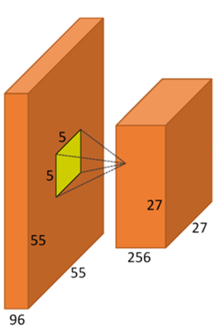
ACTIVATION FUNCTIONS?

Slide 88
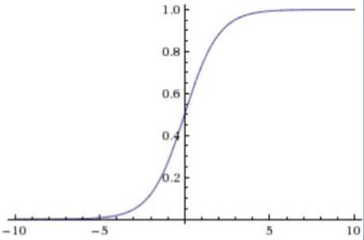
ACTIVATION FUNCTIONS?
LOGISTIC FUNCTION (“sigmoid”):
Simple
Drawbacks:
Saturates
Non-centered in zero
We don’t use it anymore, but we thank her for the services provided to the cause :)

Slide 89
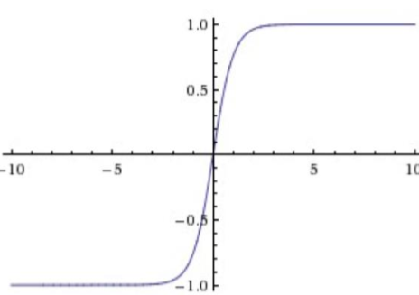
ACTIVATION FUNCTIONS?
HYPERBOLIC TANGENT (tanh):
Solves the issue with not being centered in zero
Still ‘killing gradients’ due to saturating behaviouir
It is always better than the logistic function

Slide 90
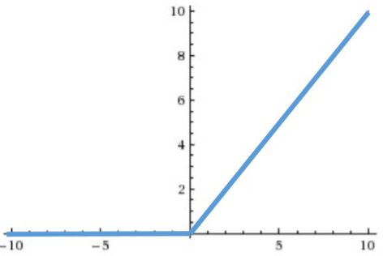
ACTIVATION FUNCTIONS?
RECTIFIED LINEAR UNITS (ReLU):
Optimization for the SGD convergence
More simple from a computational point of view
Fragile

Slide 91

ACTIVATION FUNCTIONS?
LEAKY ReLU:
More stable than traditional ReLu
Particular case of MaxOut

Slide 92

ACTIVATION FUNCTIONS?
SWISH:
Self-Gating activation function
Better performance than ReLu

Slide 93
RECTIFIED LINEAR UNITS (ReLU)
0.77 | -0.11 | 0.11 | 0.33 | 0.55 | -0.11 | 0.33
-0.11 | 1.00 | -0.11 | 0.33 | -0.11 | 0.11 | -0.11
0.11 | -0.11 | 1.00 | -0.33 | 0.11 | -0.11 | 0.55
0.33 | 0.33 | -0.33 | 0.55 | -0.33 | 0.33 | 0.33
0.55 | -0.11 | 0.11 | -0.33 | 1.00 | -0.11 | 0.11
-0.11 | 0.11 | -0.11 | 0.33 | -0.11 | 1.00 | -0.11
0.33 | -0.11 | 0.55 | 0.33 | 0.11 | -0.11 | 0.77
0.77 | 0.00 | 0.11 | 0.33 | 0.55 | 0.00 | 0.33
0.00 | 1.00 | 0.00 | 0.33 | 0.00 | 0.11 | 0.00
0.11 | 0.00 | 1.00 | 0.00 | 0.11 | 0.00 | 0.55
0.33 | 0.33 | 0.00 | 0.55 | 0.00 | 0.33 | 0.33
0.55 | 0.00 | 0.11 | 0.00 | 1.00 | 0.00 | 0.11
0.00 | 0.11 | 0.00 | 0.33 | 0.00 | 1.00 | 0.00
0.33 | 0.00 | 0.55 | 0.33 | 0.11 | 0.00 | 0.77

Slide 94

DROPOUT

Slide 95

DROPOUT

Slide 96
WHAT IS MISSING?
Filter 1
Filter 2
Filter 3
1 | -1 | -1
-1 | 1 | -1
-1 | -1 | 1
-1 | -1 | 1
-1 | 1 | -1
1 | -1 | -1
1 | -1 | 1
-1 | 1 | -1
1 | -1 | 1
How have these filters been selected/created?

Slide 97
AlexNet

Slide 98
HOW A CNN SEES

Slide 99
HOW A CNN SEES

Slide 100

HOW A CNN SEES

Slide 101

HOW A CNN SEES

Slide 102

HOW A CNN SEES

Slide 103

HOW A CNN SEES

Slide 104

HOW A CNN SEES

Slide 105


Slide 106
LAB 5: Convolutional Networks

Slide 108
Autoencoders

Slide 109




BASIC AUTOENCODER
$$\hat{x}=h_{W,b}≈x$$

Slide 110
Recurrent Neural Networks

Slide 111


HANDLING SEQUENCES

Slide 112

TRACKING THE HISTORY

Slide 113

RECURRENCE

Slide 114


Slide 115

LONG SHORT TERM MEMORY

Slide 116


Slide 117


Slide 118


Slide 119


Slide 120
Some Advanced Ideas

Slide 121

Counting people in a multitude
CONTEXTUAL PYRAMID CNN (CP-CNN)
A new method named Contextual Pyramid CNN (CP-CNN) is proposed here to generate density maps and influx estimations, by explicitely incorporating global and local context information. Composed of four modules: Global Context Estimator (GCE), Local Context Estimator (LCE), Density Map Estimator (DME) and a Fusion-CNN (F-CNN) convolutional network.
Vishwanath A. Sindagi, Vishal M. Patel; The IEEE International Conference on Computer Vision (ICCV), 2017, pp. 1861-1870

Slide 122


Slide 123


Slide 124


Slide 125
Transferring style between images
CONVOLUTIONAL NEURAL NETWORKS
By using a perceptual loss functions based on high-level features extracted from pretrained networks, networks for image transformation tasks can be trained, and by fine tuning the loss function different features can be kept for the source image and the style image.
Justin Johnson, Alexandre Alahi, Li Fei-Fei; Perceptual Losses for Real-Time Style Transfer and Super-Resolution, 2016

Slide 126


Slide 127



Slide 128


Slide 129

Using GANs to drive design decisions
GENERATIVE ADVERSARIAL NETWORKS
By taking advantage of Generational Adversarial Networks, synthetic images based on the training data can be generated. Including an external array of features, the generated images can be tailored to a specific set of requirements.
Jaime Deverall, Jiwoo Lee, Miguel Ayala; Using Generative Adversarial Networks to Design Shoes

Slide 130


Slide 131


Slide 132


Slide 133


Slide 134
DEEP LEARNING - MOVING FAST!
Swish Activation Function
Capsule Networks
…

Slide 135
SOME INTERESTING PAPERS
“ImageNet Classification with Deep Convolutional Neural Netowrks”
[Krizhevsky, Sutskever, Hinton]
http://www.cs.toronto.edu/~fritz/absps/imagenet.pdf
“Visualizing and Understanding Convolutional Networks”
[Zeiler, Fergus]
arXiv: 1311.2901v3
“Optimization Methods for Large-Scale Machine Learning”
[Bottou, Curtis, Nocedal]
arXiv: 1606.04838v2

Slide 136
SOME INTERESTING PAPERS
“Swish: A Self-Gated Activation Function”
[Ramachandran, Zoph, Quoc V.]
arXiv: 1710.05941v2
“Dynamic Routing Between Capsules”
[Sabour, Frosst, Hinton]
arXiv: 1710.09829

